Slide 1
Topic 4 – Testing and Debugging
ITE3101 Introduction to Programming

Slide 2
Lesson Intended Learning Outcomes
Upon completion of this lesson, you should be able to:
Prepare test cases for program testing
Minimize the number of test cases for selections with Decision Table
Debug a program by using inline output statements
Apply 0, 1, maximum and normal test on loops

Slide 3
Why Testing?
Programmers frequently make mistake
It is not unusual to spend 40% of the total project time on testing
Life-critical software, e.g. flight control, testing can cost 3 to 5 times as much as all other activities combined
A "good" example of defective testing
The software system in new Hong Kong Airport did not work properly when it was opened in July 1998
Hundreds of scheduled flights were delayed, thousands of pieces of luggage were lost, millions of dollars in perishable goods were left to rot

Slide 4
Testing
Definition
Software testing is the process of analyzing a software item to detect the differences between existing and required conditions (that is, bugs) and to evaluate the features of the software item
The main purpose of testing
To cause failures in order to make faults visible
So that the faults can be fixed and not be delivered to users

Slide 5
Testing Stages
Testing should proceed in incremental stages
The most widely used testing process has three stages
Unit testing
Individual program units are tested independently to ensure correct operation
Integration testing
Finding errors resulting from interactions between program units
Acceptance testing
Program is tested with user supplied data
May reveal errors in the requirements definition

Slide 6
Test Case
A test case is
A set of test inputs, execution conditions, and expected results developed for a particular objective
To exercise a particular program path with a specific requirement

Slide 7
Test Case Design
Having proper test cases is essential to successful testing
The goal is to prove that a program is incorrect, NOT to prove it is correct
Select test cases to ensure that if there is an error in the program, then it is detected by one of the test cases
A successful test is one that uncovers an undiscovered error

Slide 8
Exhaustive testing
The ideal set of test cases
It includes all the possible inputs to the program
Not practical because the number of elements in the input domain is usually extremely large
Example – Converting an integer mark (0-100) into a grade (A-F).
Total 101 test cases, i.e. 0, 1, …, 100

Slide 9
Test Case Design
All the faults in a program cannot be practically revealed by testing
The goal of test case selection
To select the test cases such that the maximum possible number of errors faults is detected
By the minimum possible number of test cases

Slide 10
Two Basic Classes of Software Testing
Black-box Testing (Functional Testing)
It ignores the internal mechanism of a program and focuses only on the outputs generated in response to selected inputs
White-box Testing (Structural Testing)
It takes into account the internal mechanism of a program

Slide 11
Block-Box vs. White-Box Testing
Input (Test cases)
test selections, loops
(Block-box)
Executable Program
(White-box)
Executable Program
Output
(Is it same as expected result?)
statement coverage &
decision coverage

Slide 12
Black-Box Testing
It have little concern for the internal structure of the program, the only concern is inputs and outputs
Test cases in black-box testing should be derived using the following methods
Partition
Boundary values
Error Guessing
Random

Slide 13
Partition
For each of the inputs and outputs of a program, consider partitions of values
For inputs, consider in addition the possibility of invalid values
Example - An employeeAge value ranging in 16-65. There are two categories: 16-60 and 61-65
In addition to the valid range (16-65), two invalid partitions arise as (<16) and (>65)
Four partition for inputs
<16, 16-60, 61-65, >65
Choose at least one value from each partition
At least 4 test data for this case, e.g. 13, 45, 62, 72

Slide 14
Boundary Values
Experience indicates that errors are likely to occur at the boundaries of partitions
If a program works correctly for some special values then it will likely work correctly for all values in between
boundaries: maximum, minimum
just inside/outside boundaries, e.g. maximum±1, minimum±1
typical values
error values
Example - with the age class, the following values should be includes
15, 16, 17
59, 60, 61
64, 65, 66

Slide 15
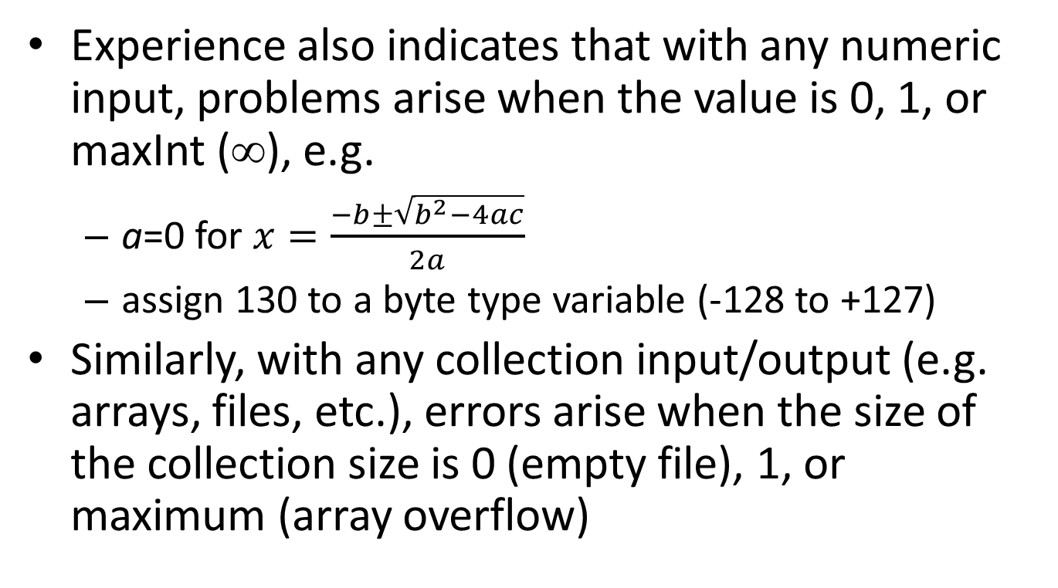
Error Guessing
Experience also indicates that with any numeric input, problems arise when the value is 0, 1, or maxInt (∞), e.g.
a=0 for $x=\frac{−b±\sqrt{b^{2}−4ac}}{2a}$
assign 130 to a byte type variable (-128 to +127)
Similarly, with any collection input/output (e.g. arrays, files, etc.), errors arise when the size of the collection size is 0 (empty file), 1, or maximum (array overflow)

Slide 16
White-Box Testing
It tries to choose a set of independent paths that guarantee each statement (statement coverage) and each selection (decision coverage) can be executed at least once
Decision coverage is stronger than statement coverage
It requires every possible outcome of all decisions to be executed at least once

Slide 17
White-Box Testing
Example - Valid data for the following conditional statement are values between 0 and 100, inclusive
y = ( x >= 0 && x <= 100 ) ? true : false;
The statement is executed no matter what value x has
If one single test case is used
statement coverage is satisfied
decision coverage is not satisfied because not all selections (both true and false) are tested

Slide 18
Testing on Selections
Decision Table is a tool to analyze the logical flow of a program with multiple selection conditions
Use Decision Table to group statements in a nested-if statement
Design at least one test case for each set of statements

Slide 19
Decision Table
if ( condition 1 ) { statement 1; statement 2; if ( condition 2 ) { statement 3; statement 4; } else { statement 5; statement 6; { } else statement 7;
Minimum three test cases to cover all statements and decisions
 | Case 1 | Case 2 | Case 3
Conditions
Condition 1 | true | true | false
Condition 2 | true | false | --
Actions
Statement 1 | ✓ | ✓
Statement 2 | ✓ | ✓
Statement 3 | ✓
Statement 4 | ✓
Statement 5 |  | ✓
Statement 6 |  | ✓
Statement 7 |  |  | ✓

Slide 20
Testing on Simple Loops
The following sets of tests can be applied to simple loops, where N is the maximum number of allowable passes through the loop
Skip the loop entirely (0 passes)
Only one pass through the loop (1 pass)
k passes through the loop (2≤k≤N)
N passes through the loop

Slide 21
a, b are int and d is boolean variables
Different white-box tests on the following two programs for checking if a is divisible by b
Using % operator
d = ( a % b ) == 0; System.out.println( "d=" + d );
Using a loop
while ( a >= b ) a -= b; d = a == 0; System.out.println( "d=" + d );

Slide 22
Debugging
Debugging = Finding and fixing errors
Three types of errors
Syntax error
Easy to find and fix
Finding by the compiler, javac.exe
Runtime error
Finding by JVM, java.exe
Based on different test cases
Logic error
May not easy to find
Finding by the programmer, designer or even user

Slide 23
Examples(Print the contents of the array) – Typos is the Main Sources of Errors
NO error
for ( int i=0; i<array.length; i++ ) System.out.println( array[i] );
Syntax error
for ( int i=0; i<array.length, i++ ) System.out.println( array(i) );
Runtime error
for ( int i=0; i<=array.length, i++ ); System.out.println( array[i] );
Logic error
for ( int i=1; i<array.length, i++ ) System.out.println( array[i] );

Slide 24
Debugging Techniques
Insert extra output statements to display intermediate results, e.g. contents of status variables
Example - Add println() statements in a loop body to trace the variables' values
while ( score != 0 ) { sum += score; System.out.println( "**score=" + score + " sum=" + sum ); System.out.println( "Enter next score, -1 to exit\n" ); score = input.nextInt(); }

Slide 25
Debugger
If you are using IDE tools, e.g. Eclipse, for program development, you can use the debugger to debug your program
Terms used in a debugger
Break Points
Step Into
Step Over
Watch

Slide 26
Summary
The purpose of testing
Software testing stages
Design test cases for different program structures
Black-Box and White-Box Testing
Testing on selections
Testing on simple loops
Debugging and debugging techniques

Slide 27
References
References:
Laurie Williams (2009). A (Partial) Introduction to Software Engineering Practices and Methods (9th ed.). Search "Williams-draft-book.pdf" on Google
(1990). IEEE Standard 610.12-1990, IEEE Standard Glossary of Software Engineering Terminology, IEEE

